Slide 1
Software Engineering and Architecture
Pattern Catalog: Adapter

Slide 2
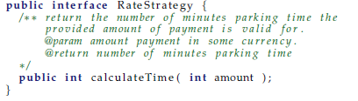

Motivation
LunaTown requirement
  The rate should correlate the phases of the moon !
    Double Alpha rates at full moon ☺, normal at new moon
  You must use the implementation bought from a consultancy company (closed source! final class)
Challenge:
  The interface does not match ours ☹
Notes:
2

Slide 3
③-①-②
③-①-②: We have done almost all the steps
  ③: Encapsulate what varies (rate calculations)
  ①: We have the RateStrategy interface
But we cannot ② because the provided rate calculator does not implement RateStrategy!
    Of course, they do not know our company
But we can ② compose behavior even further to solve the problem

Slide 4
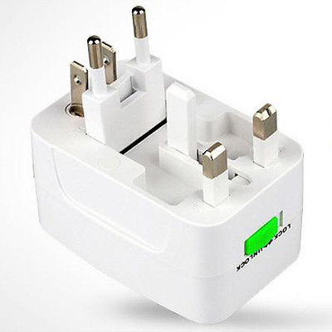
Solution
Similar to our Decorator, but now ‘inside’ the pay station, and with a purpose of “converting/adapting stuff”
PayStation Object
Third Party
Object
Adapting
Object

Slide 5
Analogy

Slide 6
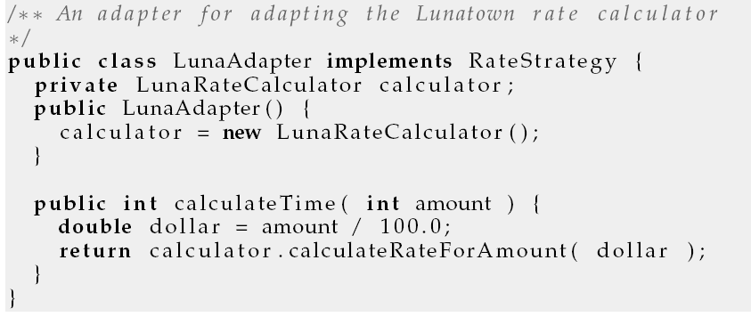
Solution: Code wise
I will put an intermediate object between the two, one that does the translation from one interface to the other:

Slide 7
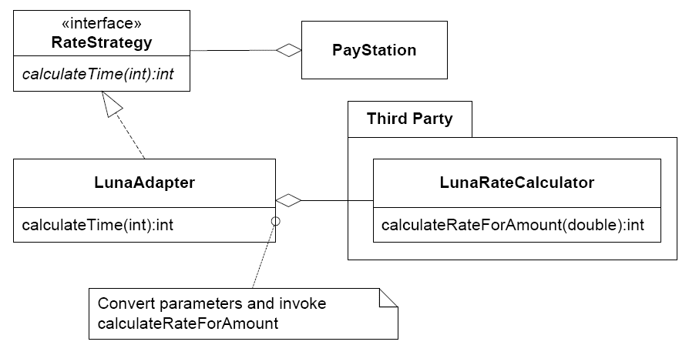
Structure of our solution

Slide 8
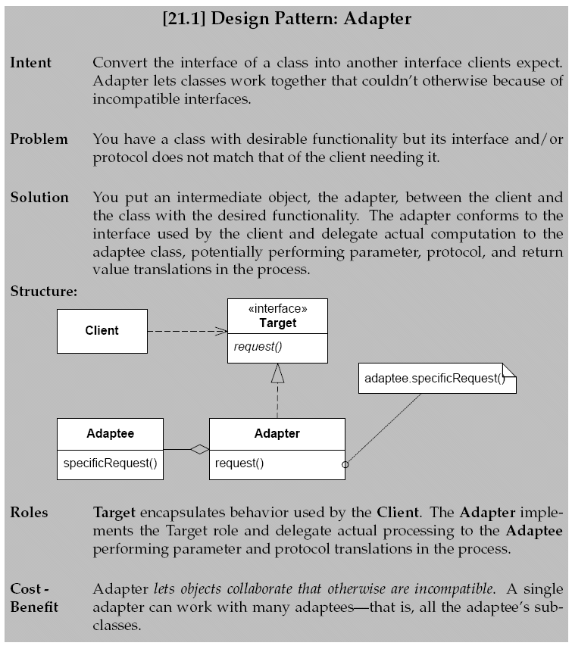

Slide 9
Consequences
Benefits
  Makes a client work with an otherwise incompatible object
  One adapter can adapt many type of adaptee’s namely all subclasses
Liabilities
  Adaptation spectrum: from simple method name conversions to radically different interfaces
    Adapters for gui toolkits

